Slide 1

Wireframe for Virtualization
By,
Ashish Chaurasia

Slide 2
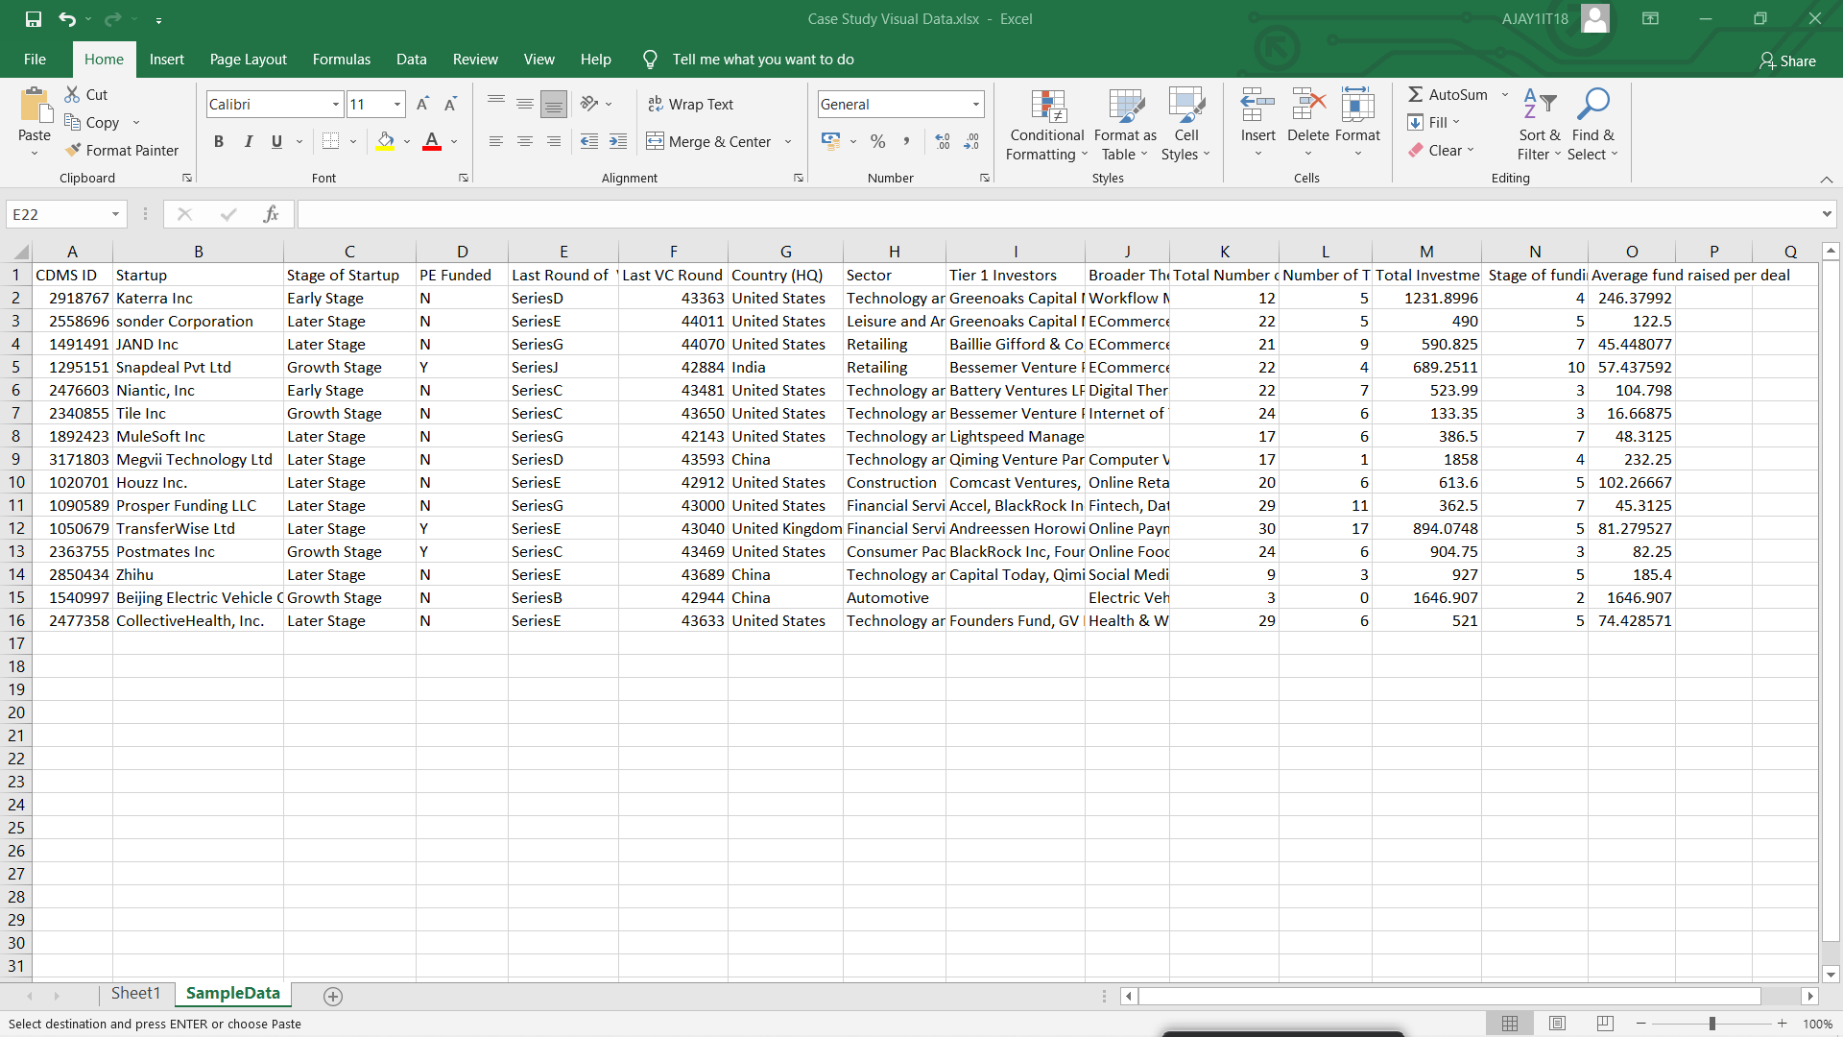
Sample Data :

Slide 3

Wire Frame

Slide 4
Estimate of Project:
By Top-Down Estimation : Breaking into parts by work
Project Estimation based on these :
Dashboards
Story
Insights of the dashboards
Creative Viz of Dashboards
Multiple No. of Sheets
Creative Designing of sheets
Wireframe
Data Cleaning

Slide 5
18% G.S.T Is not included in this estimate.
Steps to Perform | Hours Taken by specific Task | Cost of 1 hour for specific Task (Rs) | Total cost
Gathering of data & Cleaning | 1.5 hours | 300 | 450
Data Analyzing | 2 hours | 350 | 700
Creating KPI | 1 hour | 250 | 250
Creating Wireframe | 3 hours | 400 | 1200
Creating Sheets | 4 hours | 300 | 1200
Creating interactive Dashboards | 3 hours | 350 | 1050
Creating Stories | 2 hours | 300 | 600
Insights & Conclusion | 3 hours | 400 | 1200
Total Estimate | 19.5 hours |  | Rs 6,650 /-

